Slide 1

1
Bug Fix: ‘Send Report To’ not updated on action
Notes:
The second bug fix is about the department for ‘Send Report To’ not updating in the Lab Order Page.

Slide 2
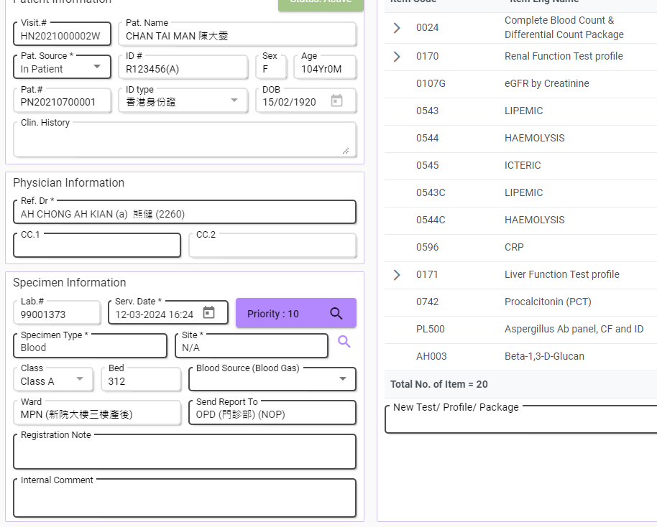
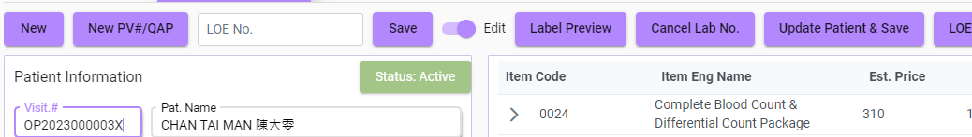

Bug fix
Before Changed
Visit Info
Order Info
Outdated Destination Report Destination was not updated even when the Ward location is changed.
Notes:
So in the LIS Lab Order page, users can enter a Visit No. and the detailed information of that Visit will be loaded from the database.
The problem with this page is that: When we loaded the information from ‘Visit No. OP2023’ for example, the Ward and the ‘Send Report To’ department were both OPD.
But after we change the ‘Visit No.’ that is having a different ‘Ward’, like the new ‘Visit No. HN2021’ with the new ‘Ward MPN’ here, then click ‘Update Patient & Save’, the updated ‘Send Report To’ field would still be the original department because there’s only information about the Visit is updated but the information of the Lab Order itself is not being considered.
And this is not a desired result as we expect the department to send report to should always be default as the location of the new Ward.
But of course users can change the Send Report To department by themselves later, we just default the Send Report To department as same as the new Ward location for a good practice.

Slide 3
Conclusion & Fix
Reason: No existing code handles the Ward and Send Report To logic.
Logic Added:
const originalWard = this.labOrder.patientVisit.deptCode;
// Fetch data from new visit
this.labOrder.patientVisit = { ...data };
// If ward has been changed, send report to the new ward
if (originalWard !== this.labOrder.patientVisit.deptCode)
this.labOrder.sendReportTo = this.labOrder.patientVisit.deptCode;
await this.departmentSearchForm
.get('displayDepartment')
.setValue({
key: this.labOrder.patientVisit.deptCode ?? : "",
value: this.labOrder.patientVisit.deptCode ?
this.displayDepartmentSuggestionItem(this.labOrder.patientVisit.dept) : "",
}),
Notes:
This bug occurs because there is no existing code handling the logic for this situation.
And here’s the logic I’ve added for this fix: This checks if the ward is being changed; If yes then set the ‘send report to’ department as the new ward location.
After this, this bug is resolved.

Slide 4
2
LIS Enhancement - Referral Test Status
Notes:
So now I will share the main focus today, which is the ‘Referral Test Status’ enhancement.

Slide 5
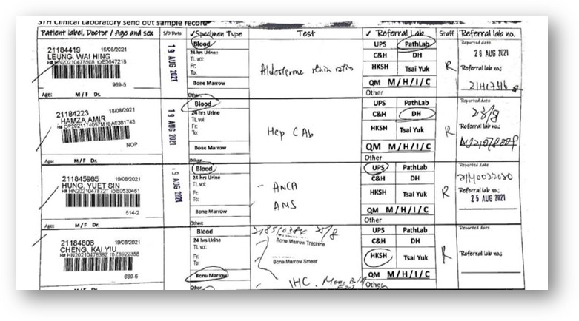
Background
Digitalize the workflow of Referral Status
Presented into an intuitive interface
Notes:
As per previous practice, lab users could only manage the referral order status on a physical handbook like in this image.
And, this enhancement allows them to manage the status of the referral tests on LIS as this has digitalized the workflow of previous practice and transformed the management of ‘Lab Order Referral Status’ into an intuitive interface.

Slide 6
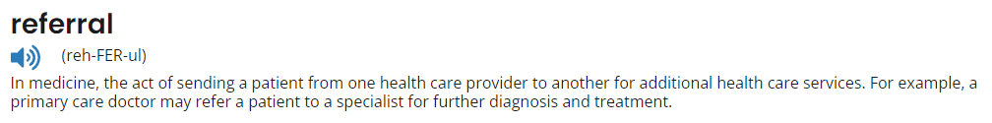
Workflow
Definition
Collect the Sample from the patient.
Verify the collected Sample.
Pack the verified Sample.
Send the packed sample to the referral lab.
Receive the test report from the referral lab.
Notes:
Before getting into the interface of the enhancement, we need to understand the rough idea of the Referral Test Status workflow.
First, lab users will need to collect sample from a patient like blood and tissue.
Then, the collected Sample need to be verified like is the sample collected from the correct patient or not.
After confirming the previous steps are not having trouble, lab users will then pack the verified Sample into one, and
Send them to the referral lab. After the referral lab finished analyzing the sample,
lab users will receive the test report from them through several ways such as True Copy, Email, or Fax.

Slide 7
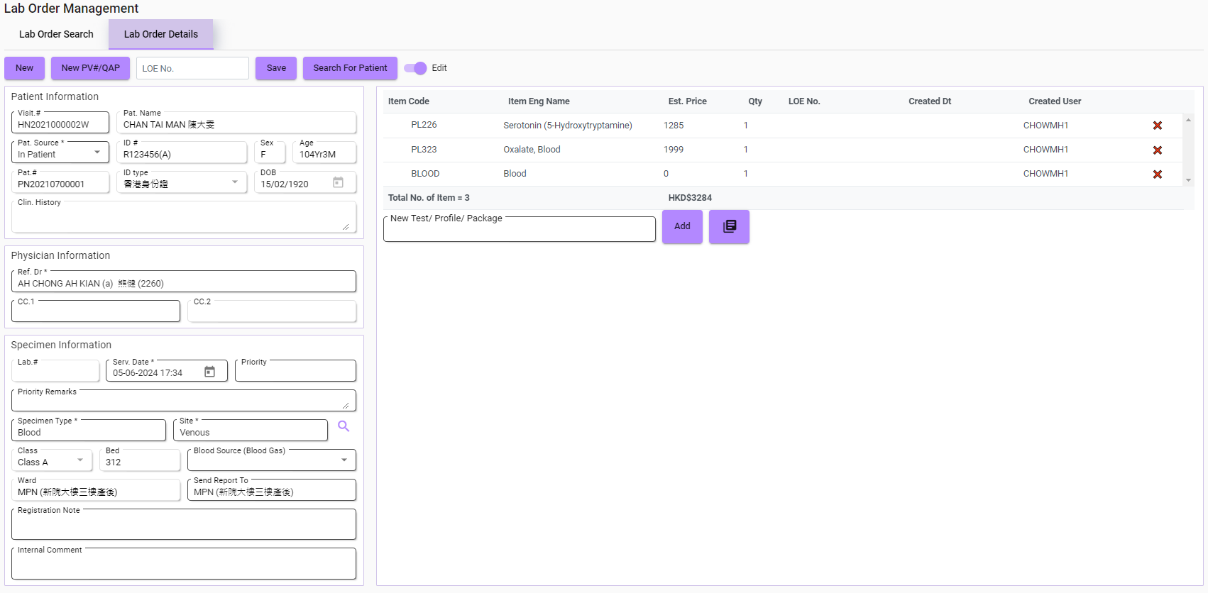
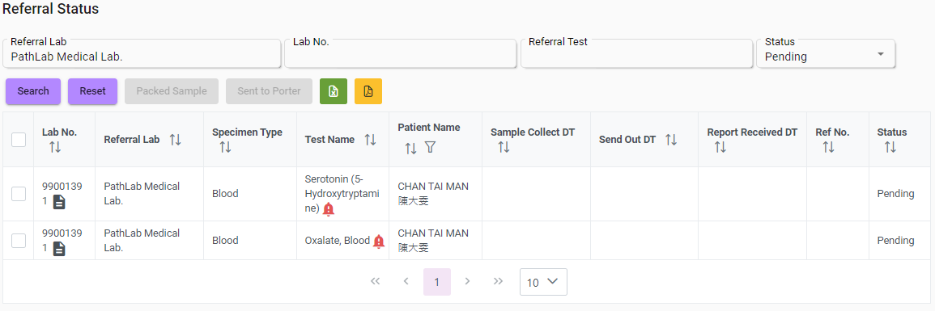
Existing Interface:
during lab order creation
IF referral test(s) exist in a new Lab Order
THEN add each referral test(s) to Referral Status page
NEW PAGE: Added Tests in Referral Status
Notes:
In this enhancement, I have also modified the web service for Lab Order.
Now, whenever there are new referral tests added in any order, they will also be added in this new Referral Status interface.
Any updates or cancellations of referral tests will also be synchronized into this new page.

Slide 8
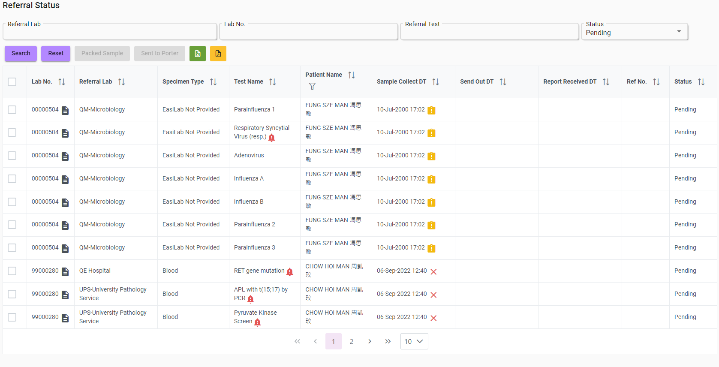
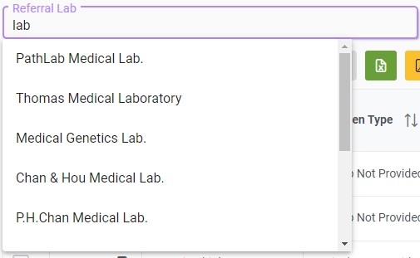
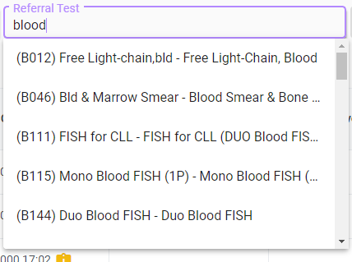
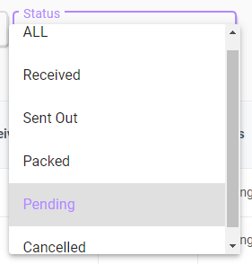
Search filter
Notes:
The selection of the filters is also referred to in its previous physical handbook.
There are four search filters in this new page:
Users can search by the referral lab, lab no., referral test, and referral status that I’ve introduced a bit about the workflow.
After the search, the inquiry result can also be exported in excel or pdf format for users needs.

Slide 9
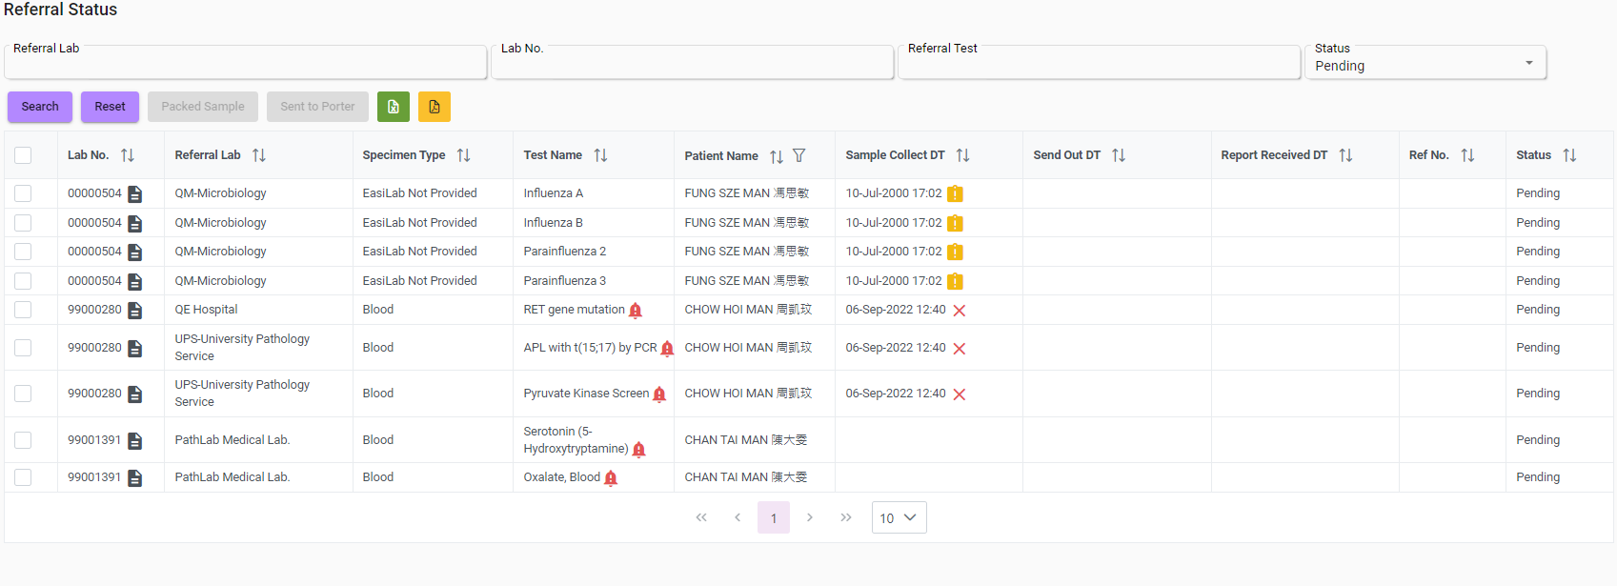

Default filter
Is Collected
Not Collected
Workflow: Pending(Collected) → Pending(Verified) → Packed → Sent Out → Received
Notes:
When we first entered the page, it will display all referral tests that are pending
so that users can have a quick look at the tests that need to be worked on.
(tap) At the column of ‘Sample Collect Date’, the row that have a collect date on it means that test is collected and vice versa.

Slide 10
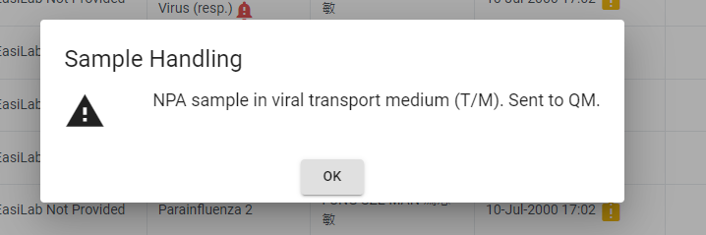
Sample Handling
Workflow: Pending(Collected) → Pending(Verified) → Packed → Sent Out → Received
Notes:
I’ve also created a red bell for the tests that need to be aware of Sample Handling.
The content (tap) will be shown after clicking the bell.

Slide 11
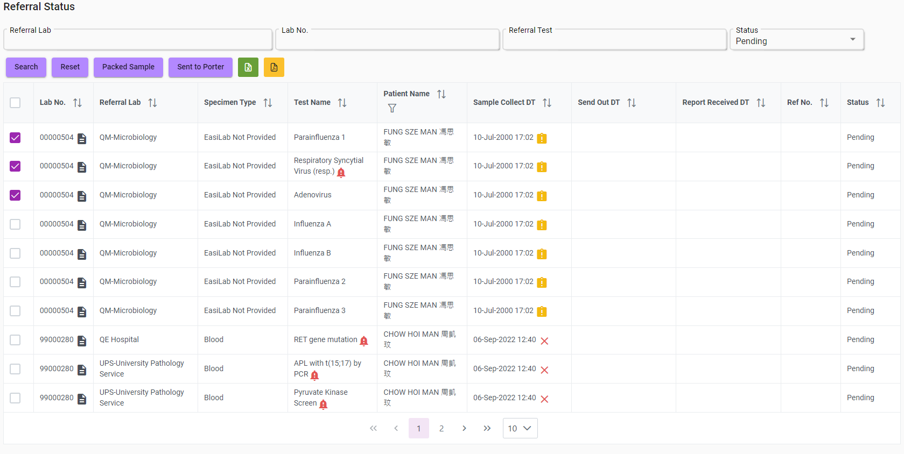

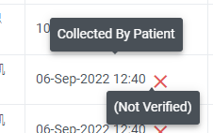

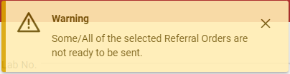
Quick update by selecting
Pack selected test(s)
Success Message
Not allowed to pack/send out
Send out selected test(s)
Fail Message
Select test(s) to pack/send out
Workflow: Pending(Collected) → Pending(Verified) → Packed → Sent Out → Received
Notes:
One of the main functions of this page is that it supports quick updates of referral status.
Users can select the tests they want to pack or send, (tap) then click one of these two buttons to pack or send all of them.
But of course, it won’t allow any tests to be packed or sent. For example, (tap) if one of the selected tests is not verified, they can’t be updated.
As we can see in the workflow under here, if any stage before the target status is not fulfilled, the whole update will be rejected.
(tap) At last, here are the success and fail messages of the update, the success message will also indicate the number of tests being updated.

Slide 12
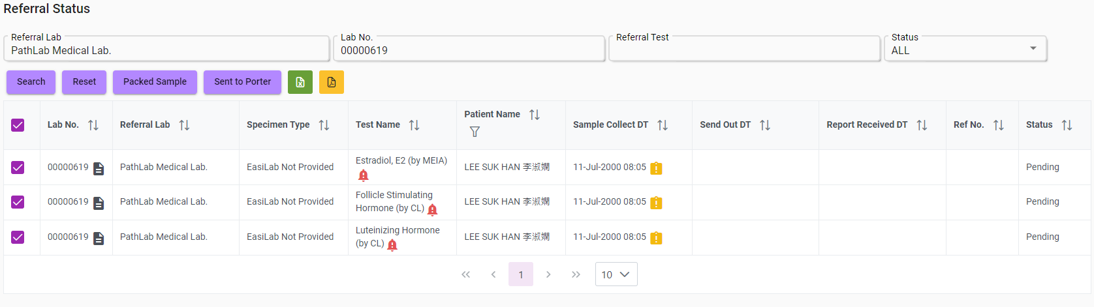
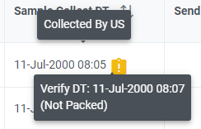
Auto-select
Logical Requirements
Pack: The sample is collected & verified.
Workflow: Pending(Collected) → Pending(Verified) → Packed → Sent Out → Received
Notes:
Another core function is the auto-select for the tests.
This will happen if the user searches by the Referral Lab and Lab No. at the same time, once it does, all of the tests in the inquiry result will be selected for update. So users can proceed with the workflow way more efficiently especially when they are dealing with a referral order containing multiple tests.
Now we can try to go through the whole workflow here one by one, (tap) starting with packing the tests.
To pack the tests, we have to confirm that their sample is all collected and verified.
By hovering our cursor on the collect date, we can see all of the tests are collected and verified, which means everything is good to go.
Then we can click the Pack button.

Slide 13
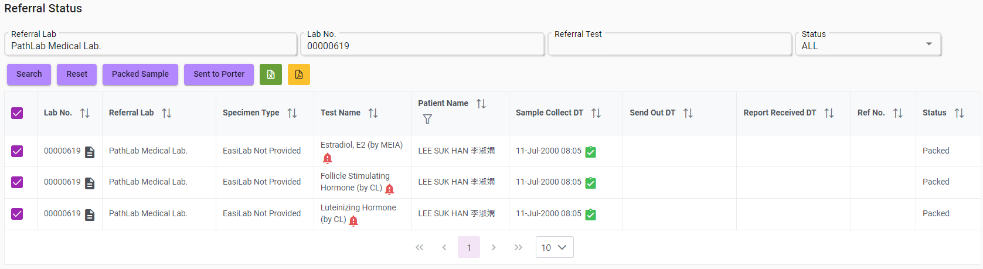
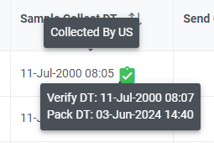
Auto-select
Logical Requirements
Send out: The sample is packed.
Workflow: Pending(Collected) → Pending(Verified) → Packed → Sent Out → Received
Notes:
Now we can see these tests are all packed and the tiny icon is also changed into a green box with a tick.
According to the workflow, after packing, we have to do the send-out part.
(tap)
To send the tests, we have to confirm that they are already packed.
By hovering the cursor on the collect date again, we can see the Pack Date is properly updated.
So we can click the Send button.

Slide 14
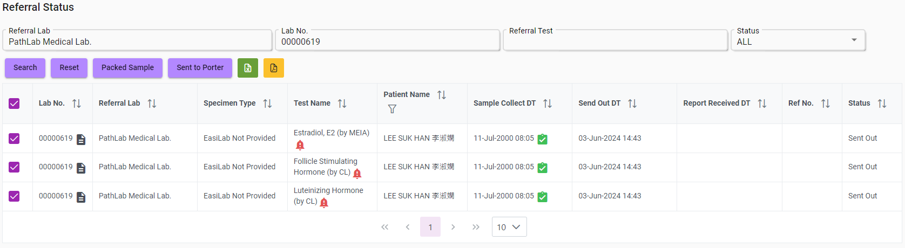
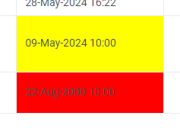
Auto-select
Unreceived Sent Sample before 2 Weeks
Unreceived Sent Sample before 1 Month
Workflow: Pending(Collected) → Pending(Verified) → Packed → Sent Out → Received
Notes:
Now, every test is sent and the Send Out Date is also being updated.
For the Send Out Date column, there is also a feature that (tap) will set its background to yellow or red.
If the Sent date is already 2 weeks ago and it’s not received yet, it will turn yellow; if it’s a month, it will turn red.
This could alert the users for tests that are delaying too long, then they might need to call the corresponding referral lab to check if anything goes wrong.

Slide 15

Test Detail
Workflow: Pending(Collected) → Pending(Verified) → Packed → Sent Out → Received
Notes:
After we arrived at the Sent Out stage of the workflow, we could not use the quick-update function anymore since report receiving requires more complex information.
So we have to click on the paper icon inside the Lab No. column of a test to open the details of that test.

Slide 16
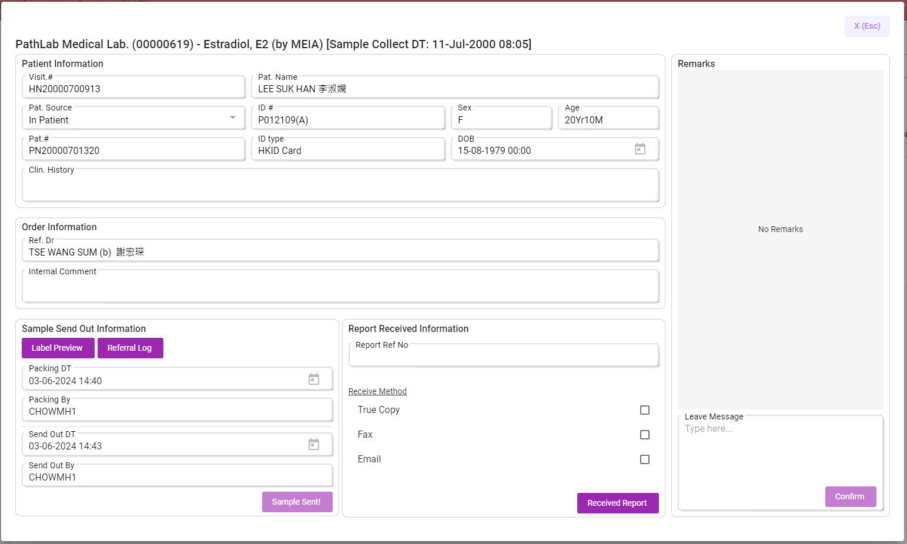
Test Detail
Read-only Info
Referral Lab (Lab No.) – Test Name [Sample Collect Date]
User comment box
User Input Form
Notes:
Here’s the test detail page:
At the top of the page, we can check the Referral lab, Lab No., Test name, and Sample collect date of the test.
Below is the information for the patient and the lab order, they are read-only and only provide the context of the test.
These two forms are the information for Sample Send Out and Report Receiving, which is input by users.
We can see the information for pack and send is filled as we just completed them by quick-update.
The rightmost side is the chat box for users leaving messages about the tests, and it will also be introduced in later slides.
Starting with the (tap) ‘Sample Send Out’ form.

Slide 17
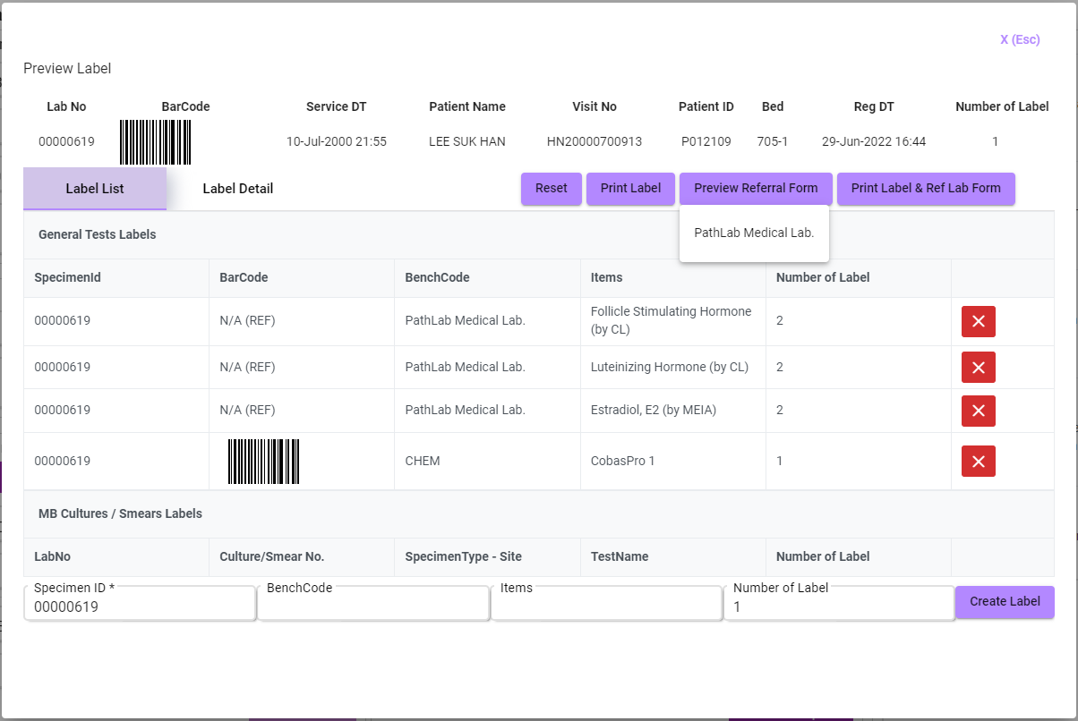
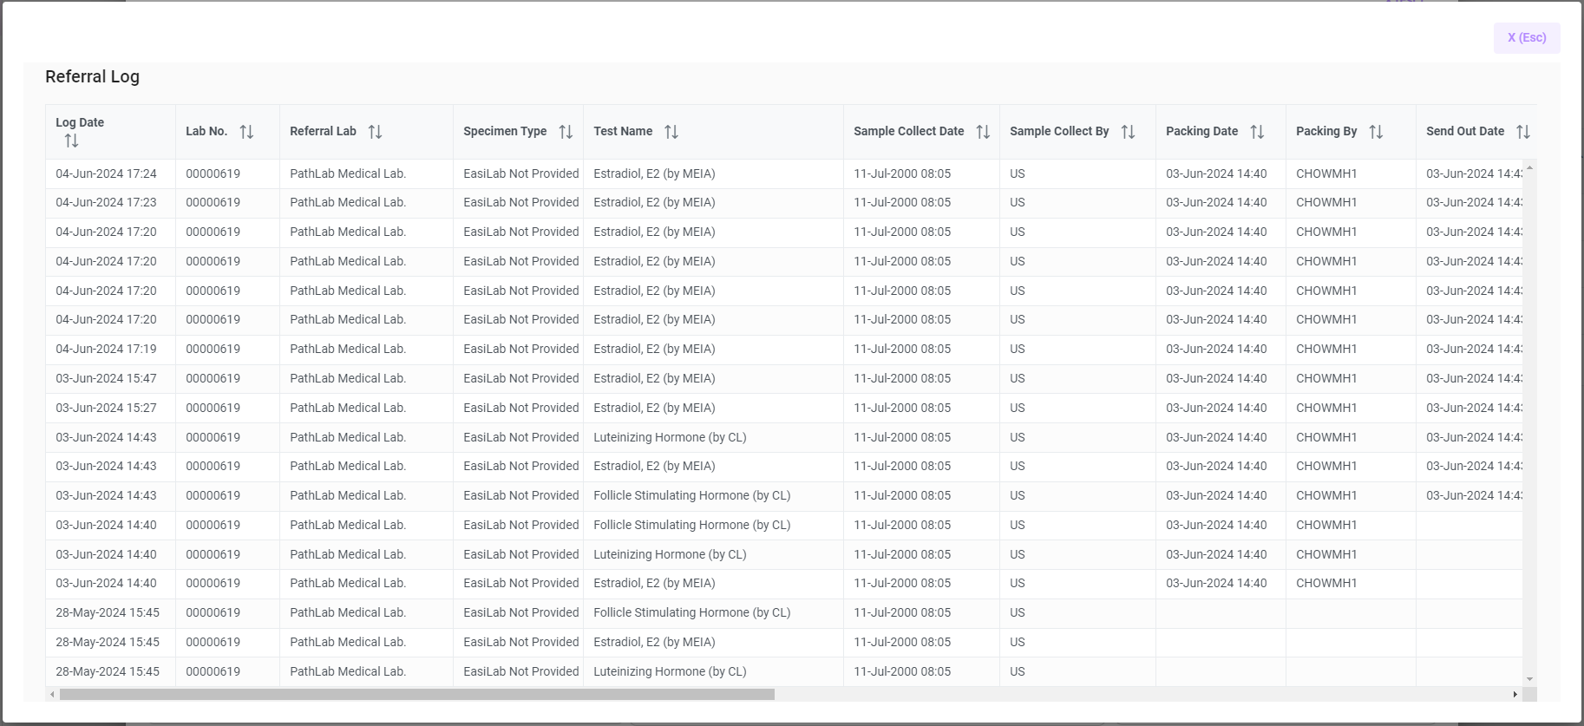
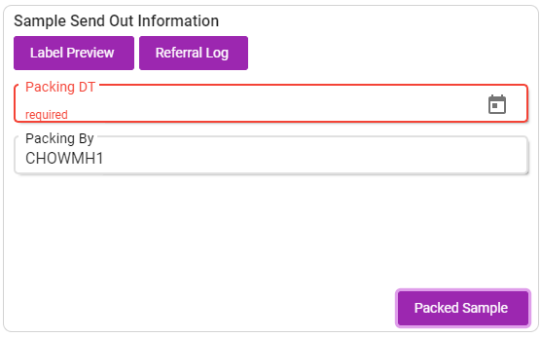
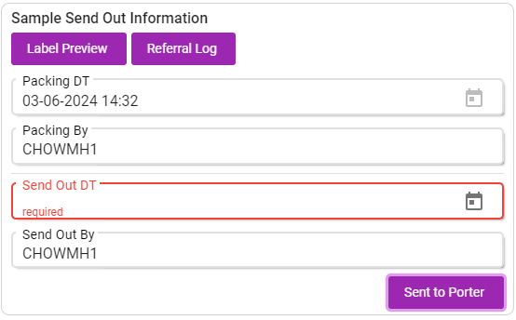
Test Detail – Pack & Send Out
Workflow: Pending(Collected) → Pending(Verified) → Packed → Sent Out → Received
Notes:
Users can input the pack and send out information through this form instead of quick-updating.
A simple logic check is also created here to make sure that the sample pack date must be before the sample collect date etc., similar things also apply to the send-out date and received date.
The user names for packing and sending out here are also automatically filled.
And (tap) the ‘Label Preview’ button here also allows users to view the referral label without going to another page.
The (tap) ‘Referral Log’ button also enables users to check the updates that have been made to the related order.

Slide 18
Test Detail
Read-only Info
Referral Lab (Lab No.) – Test Name [Sample Collect Date]
User comment box
User Input Form
Notes:
Now, we can talk about the (tap) ‘Report Received’ form.

Slide 19
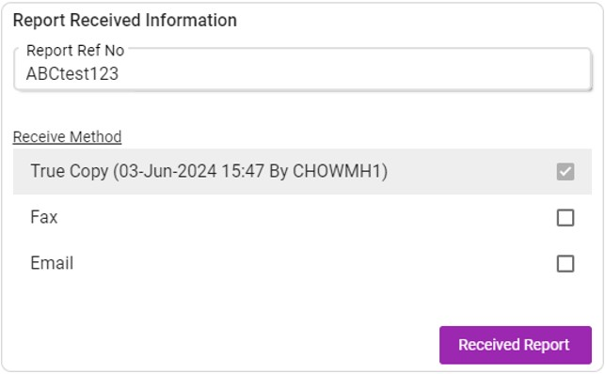
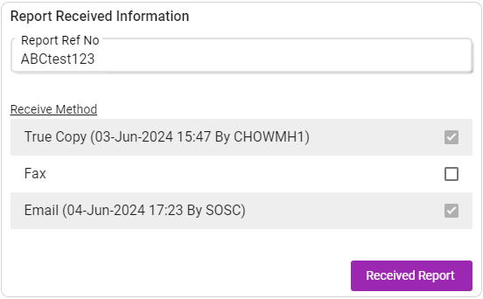
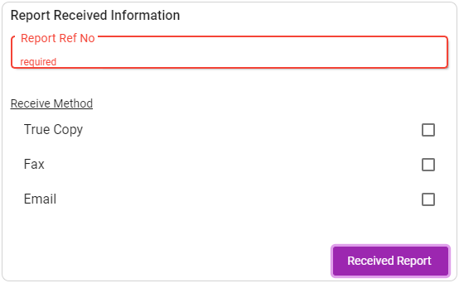
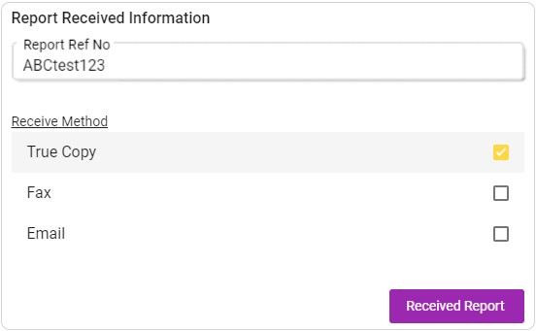
Test Detail – Receive Report
from Referral Lab Report
Workflow: Pending(Collected) → Pending(Verified) → Packed → Sent Out → Received
Workflow: Pending(Collected) → Pending(Verified) → Packed → Sent Out → Received
Notes:
At the Receive form, users have to (tap) input the Report Referral Number they received from the referral lab report.
Then, they need to select at least one method of how they received the referral report.
After submitting this form, (tap) the report referral number and the submitted method will not be able to be changed anymore and the received information of specific methods will be updated next to the method name.
In case users receive any other version of the report later, they can always go back to the form and update a new method into it.
(tap) And the form will also support multiple users submitting different methods.

Slide 20
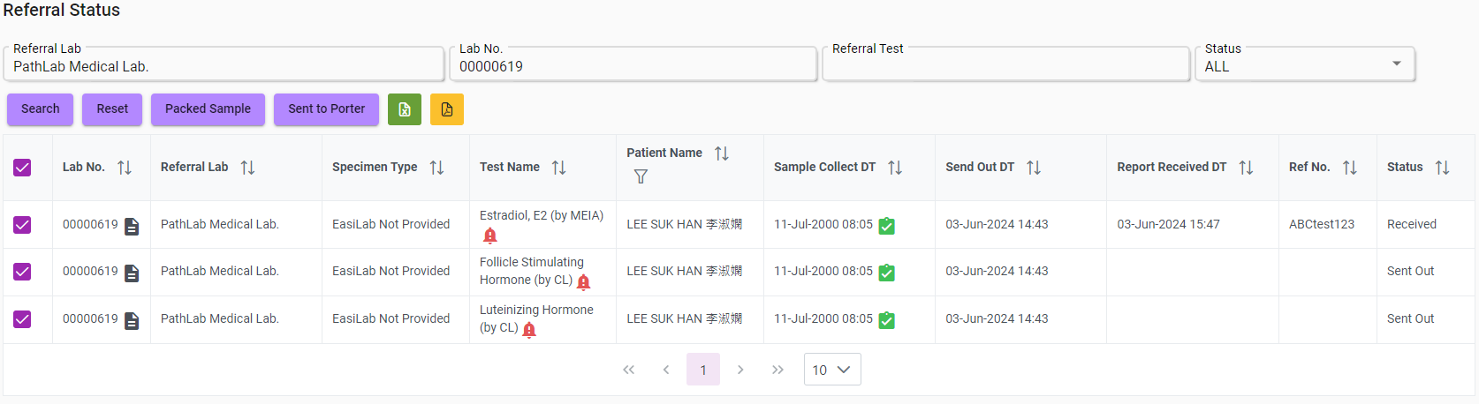
Test Detail – Receive Report
Take the earliest received date
Workflow: Pending(Collected) → Pending(Verified) → Packed → Sent Out → Received
Notes:
So finally after inputting the received information, we arrived at the end of the workflow.
The ‘Report Received Date’ will be updated as the earliest received date among multiple methods.
As we inputted previously, the date receiving the true copy is earlier than the email version, so we display true copy’s receive date.

Slide 21
Test Detail
Read-only Info
Referral Lab (Lab No.) – Test Name [Sample Collect Date]
User comment box
User Input Form
Notes:
Now, we can introduce the (tap) comment box component.

Slide 22
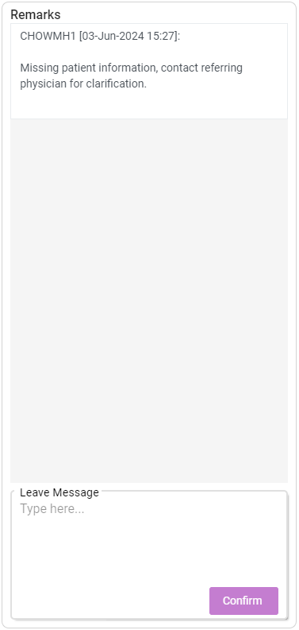
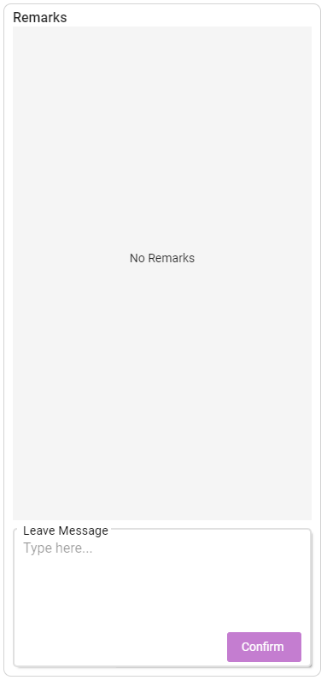
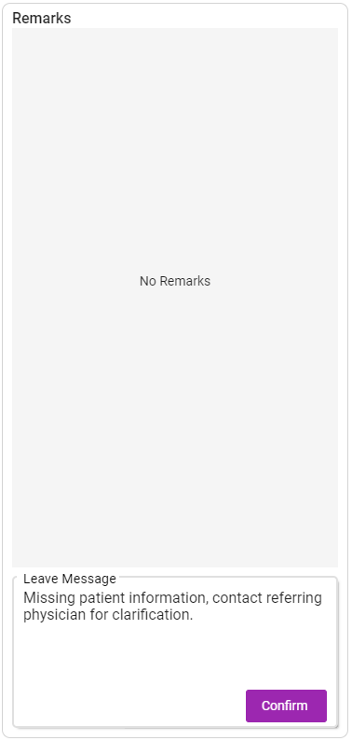
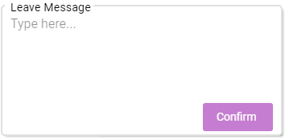
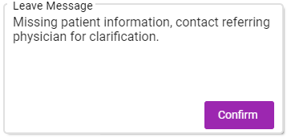
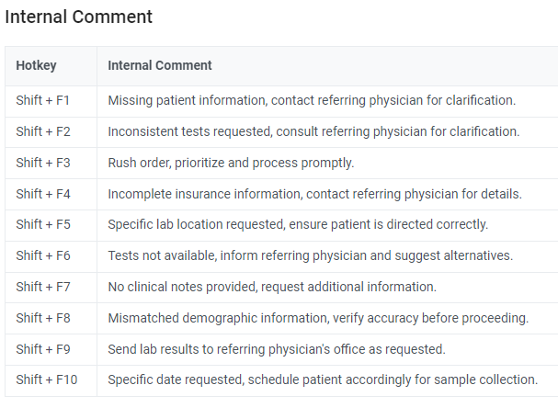
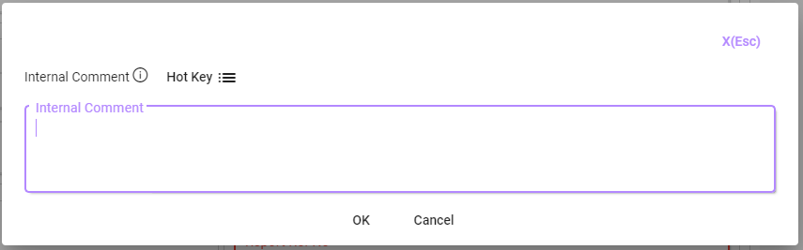
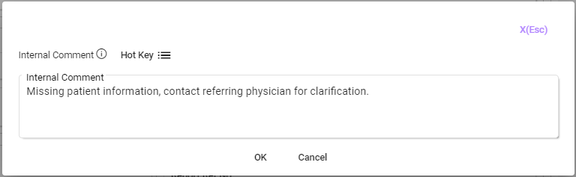
Test Detail – Remarks
(Double-Click)
Notes:
In this chat box, users can either type directly inside the message box or double-click it to enter the internal comment box.
By clicking the (tap) Hotkey icon, a list of preset comments will be listed and these comments can be modified by users themselves on the settings page.
Then, users can now use the hotkey or directly double-click on one of the comments to (tap) apply a comment.
And (tap), the comment is ready to be sent. (tap)

Slide 23
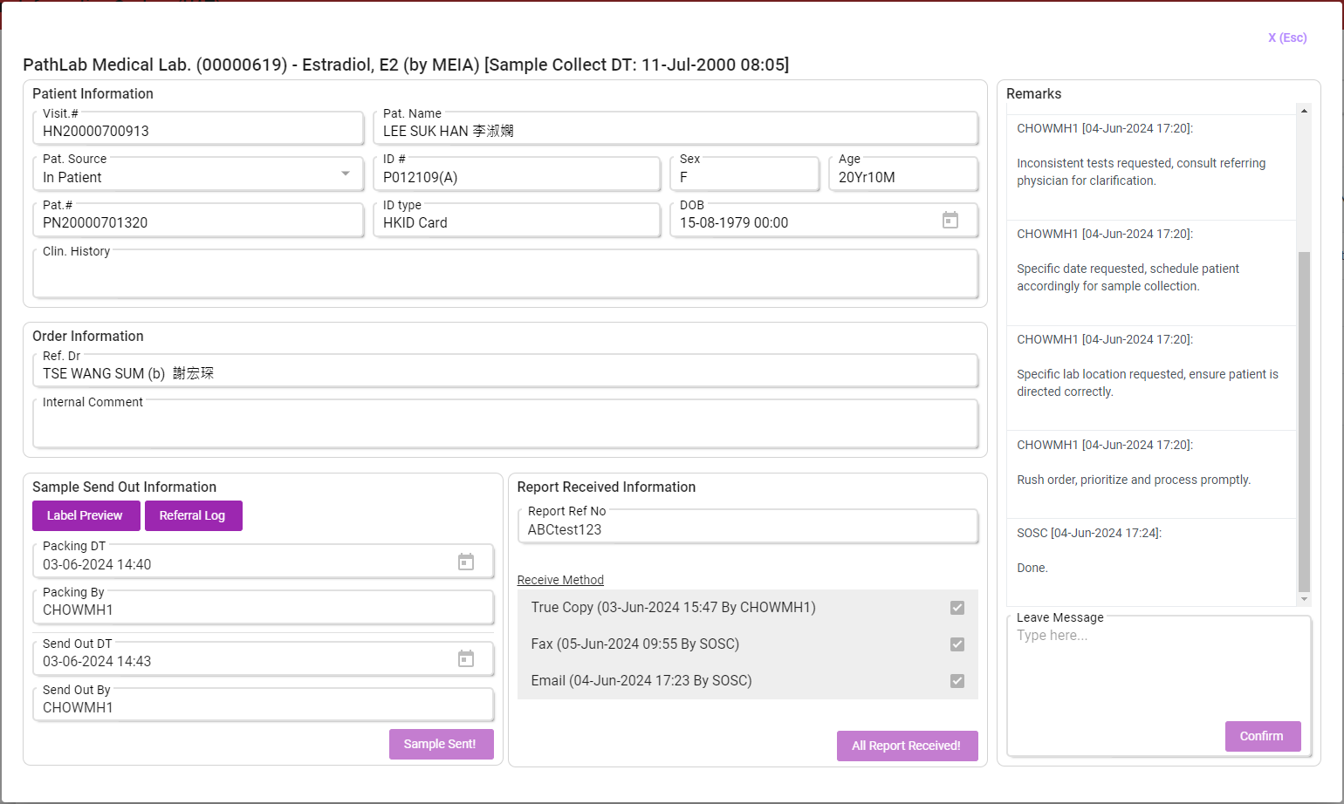
Test Detail – Completed form
Notes:
This is how the detail page could look after completing the whole workflow.
Users can communicate using the Remarks chat box.

Slide 24
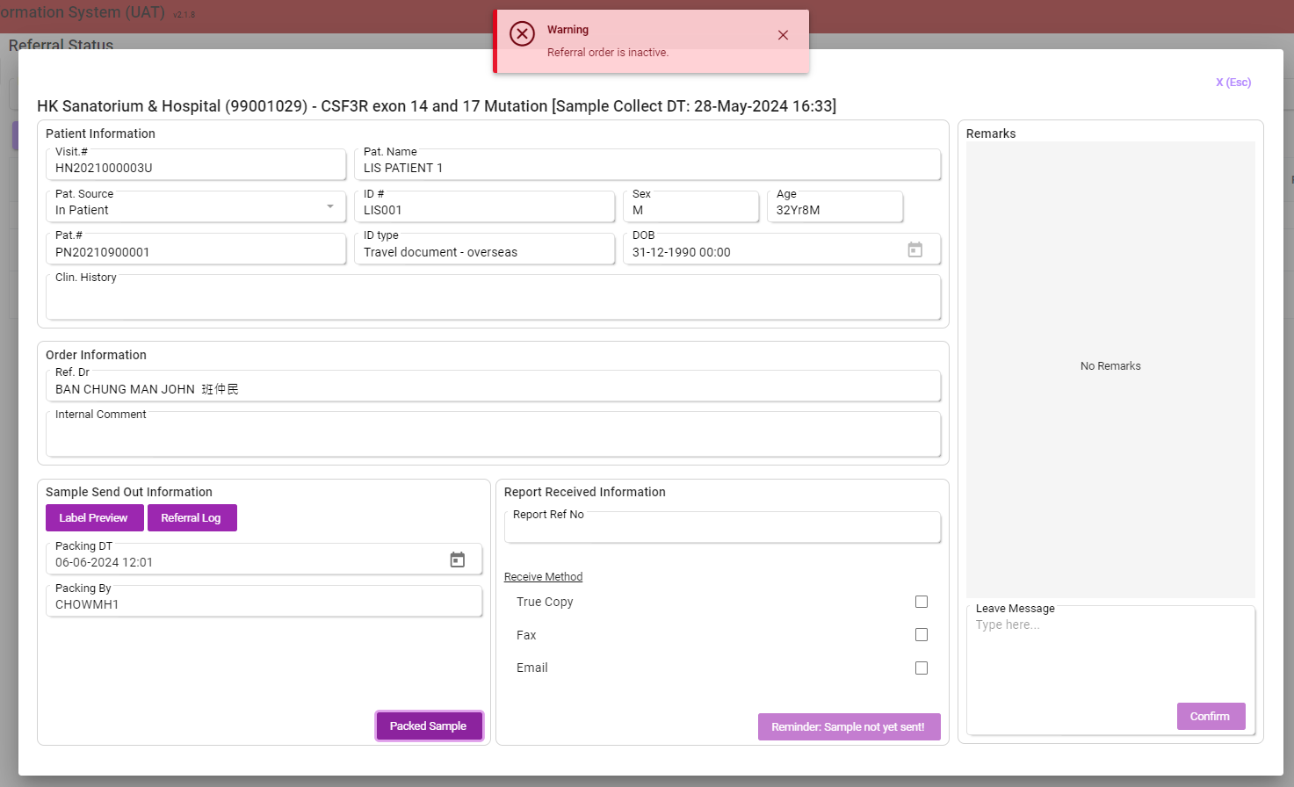
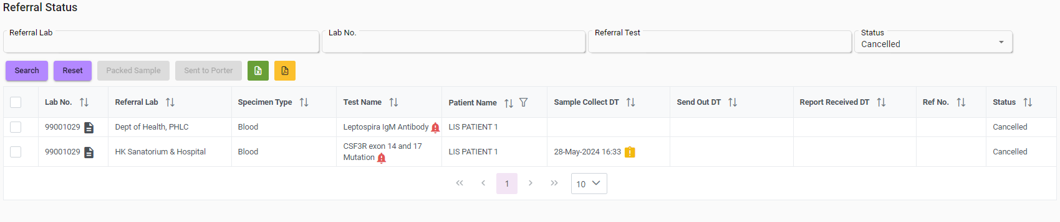
Cancelled Test
Notes:
The last thing worth mentioning is that if any referral tests are cancelled on the Lab Order Page, the corresponding tests will be labeled with the cancelled status. That means (tap) it could not be updated in any ways as it is already inactive.
But I still let users to use the comment box in case they need to leave some remarks on the cancelled test.

Slide 25
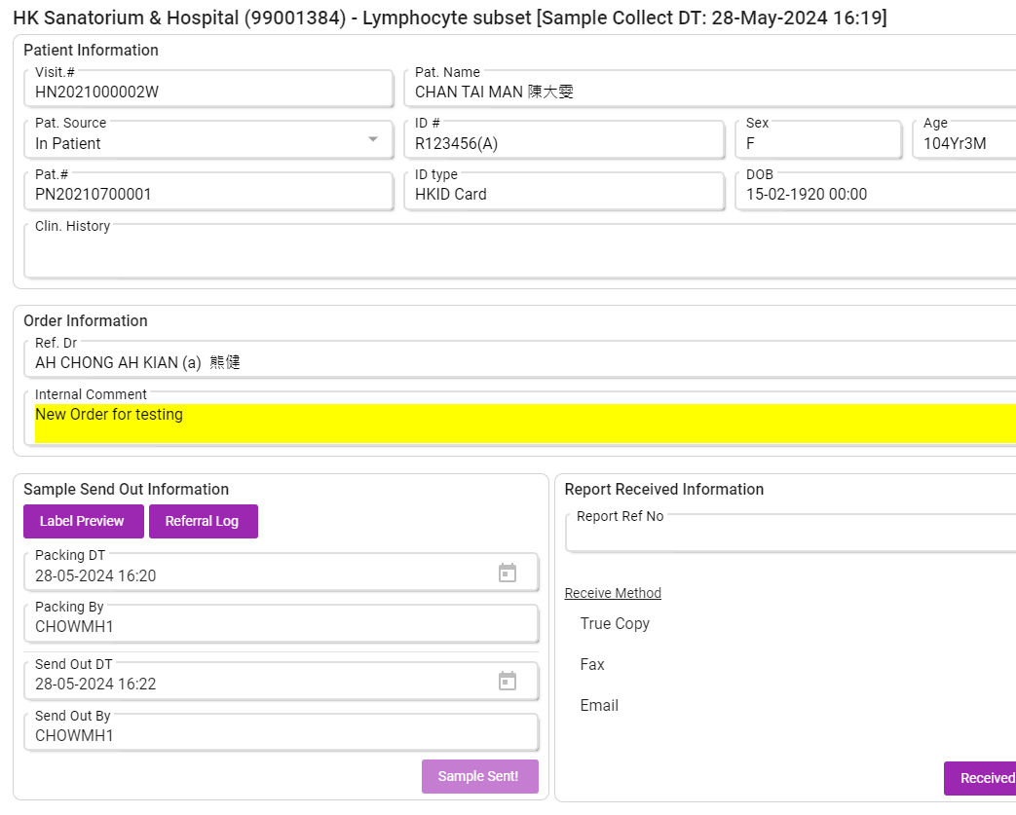
Referral Log
History Tracking Inquire for updates and related information on Referral Test Status.
Notes:
This log page was also introduced when we were talking about the ‘Sample Send Out’ page.
It lets users track updates and related information during the Referral Status workflow.

Slide 26
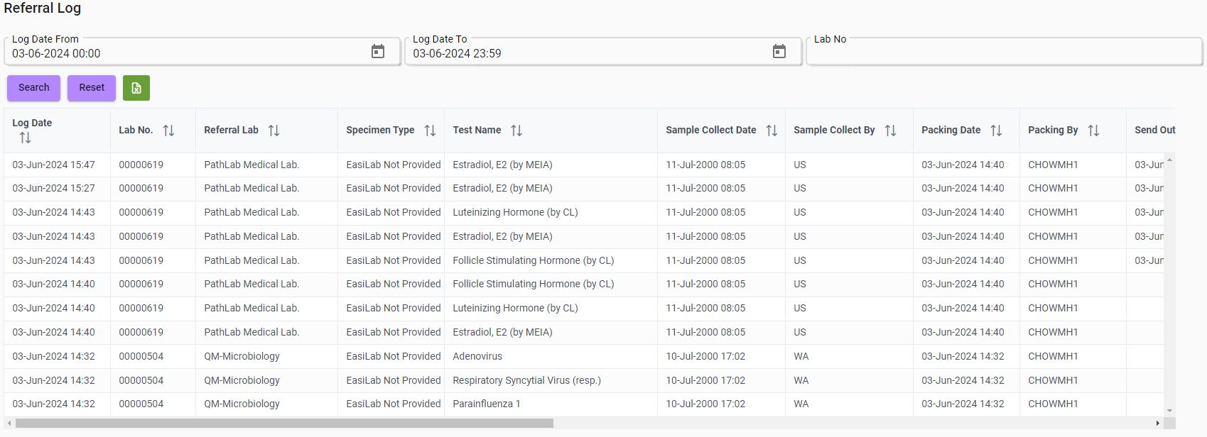
Export as Excel
Notes:
This is the Referral Log page by itself, users can search by log date and Lab No. And its inquiry result can also be export as excel.

